Slide 1
Fall/Winter Co-op OutBrief
NASA GOES-R Program
Anthony Sangrigoli
Software Engineer

Slide 2
Anthony’s Individual Work
IT Help Desk
Imaging computers
Setting up secure flash drives
Web Development
GOES App Status Portal
COWS Project
Weather Station Website
Arduino/Raspberry Pi Software
Notes:
Throughout my time here at NASA, I got to work with the IT team imaging computers and setting up secure flash drives.
I got to worked with the development team creating the GOES App Status Portal.
I also was apart of the coop Weather Station side project building the Website.
I got a lot of exposure developing programs for the Arduino and Raspberry Pi.

Slide 3
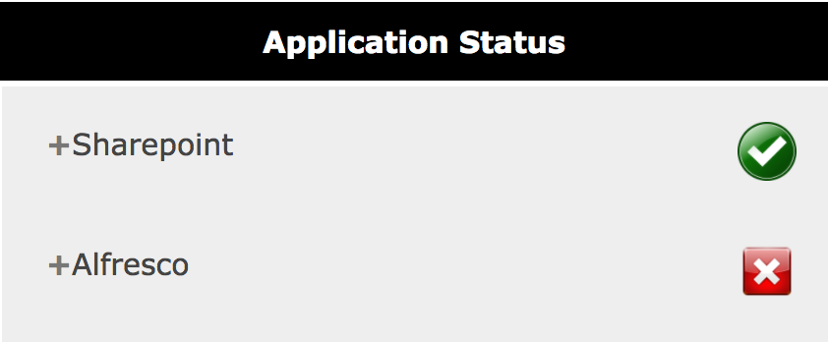
GOES App Status Portal
GOES App Status Portal provides a real-time view of the performance and uptime of our GOES applications and services.
Status of application is either displayed as Online (Green Checkmark) or Offline (Red X)
Current Apps include: SharePoint, Alfresco, Prophawk, Library, Contingency, Windchill, IRMA
Notes:
GOES App Status Portal is basically a webpage that provides a real-time view of the performance and uptime of our GOES applications and services.
I wanted to supply GOES users with an easy accessible tool to view the status of all applications.

Slide 4
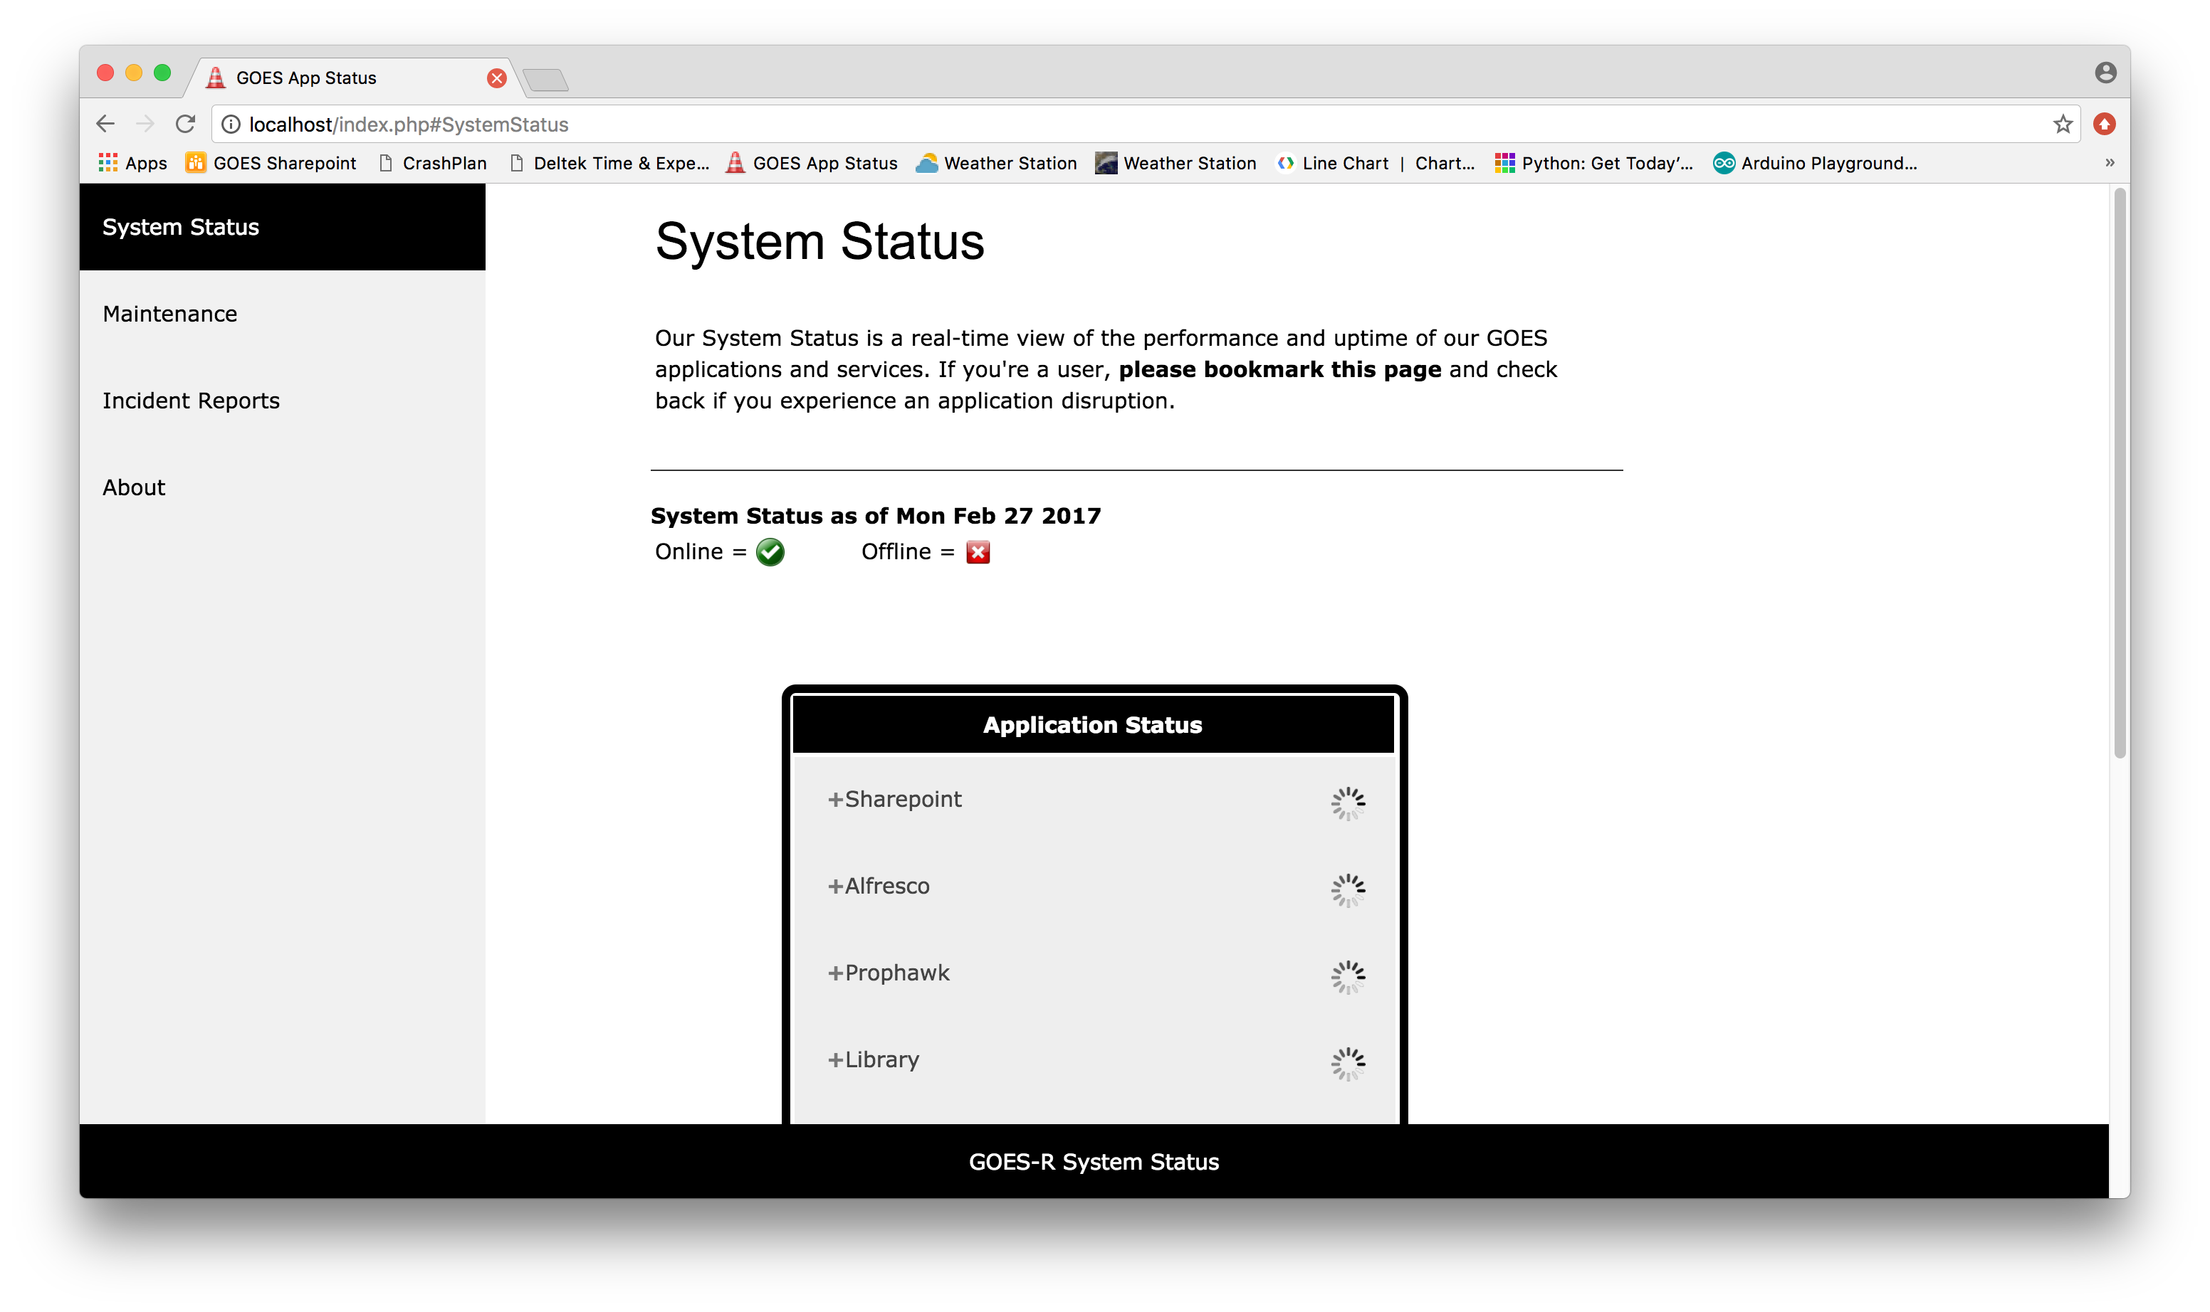
GOES App Status Portal
Notes:
When the user first hit the portal, they will be directed toward the system status homepage
The page tells the user a brief description of what the tool is and to bookmark this page incase they have trouble accessing a certain application.
In the middle of the page there is a table called Application Status, which lists each application name and also soon to be status
After few seconds, the Loading animation for each application will get updated to its current status.

Slide 5
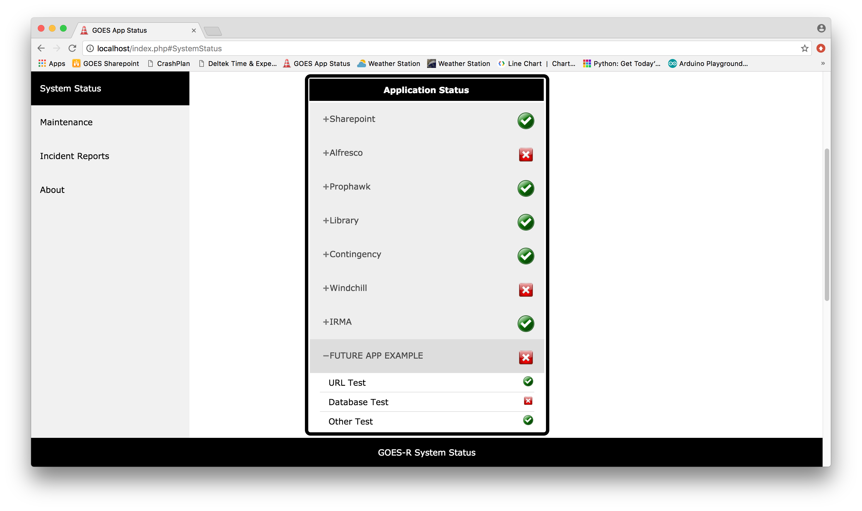
GOES App Status Portal
Notes:
The status of each application will refresh automatically every 10 seconds without having to reload the page.
This is done so by a JavaScript ajax call that executes a python script
Each application can be clicked and broken down into individual tests detailing the status of all critical parts of the application.
Future work ideas

Slide 6
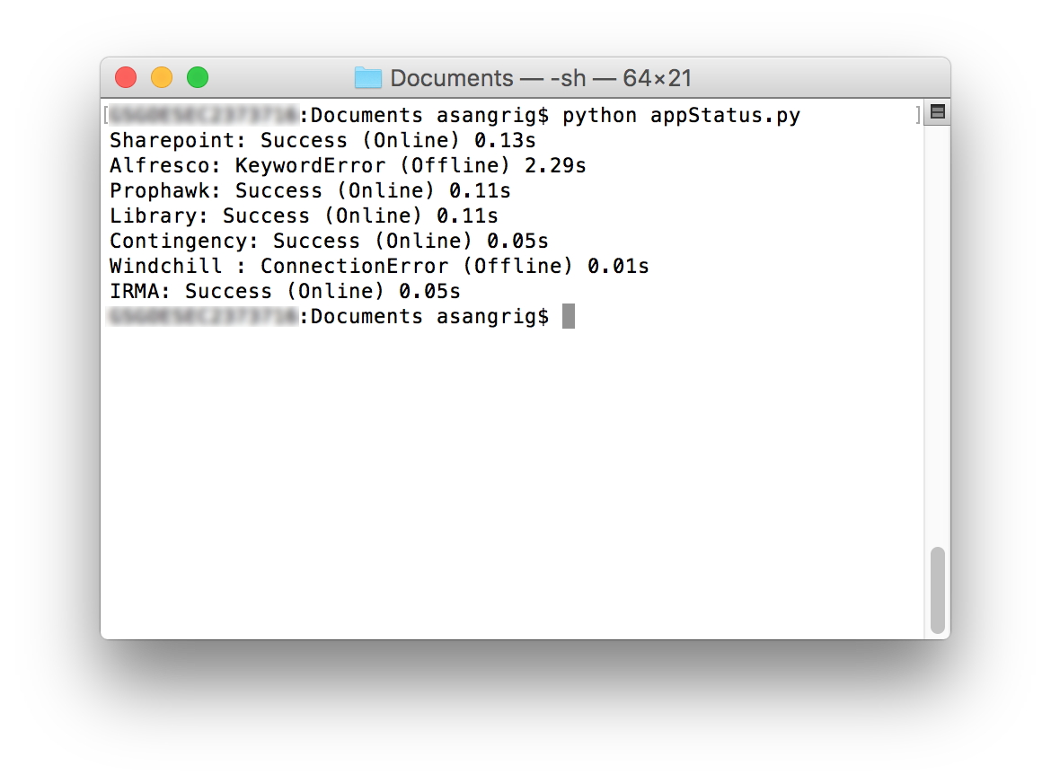
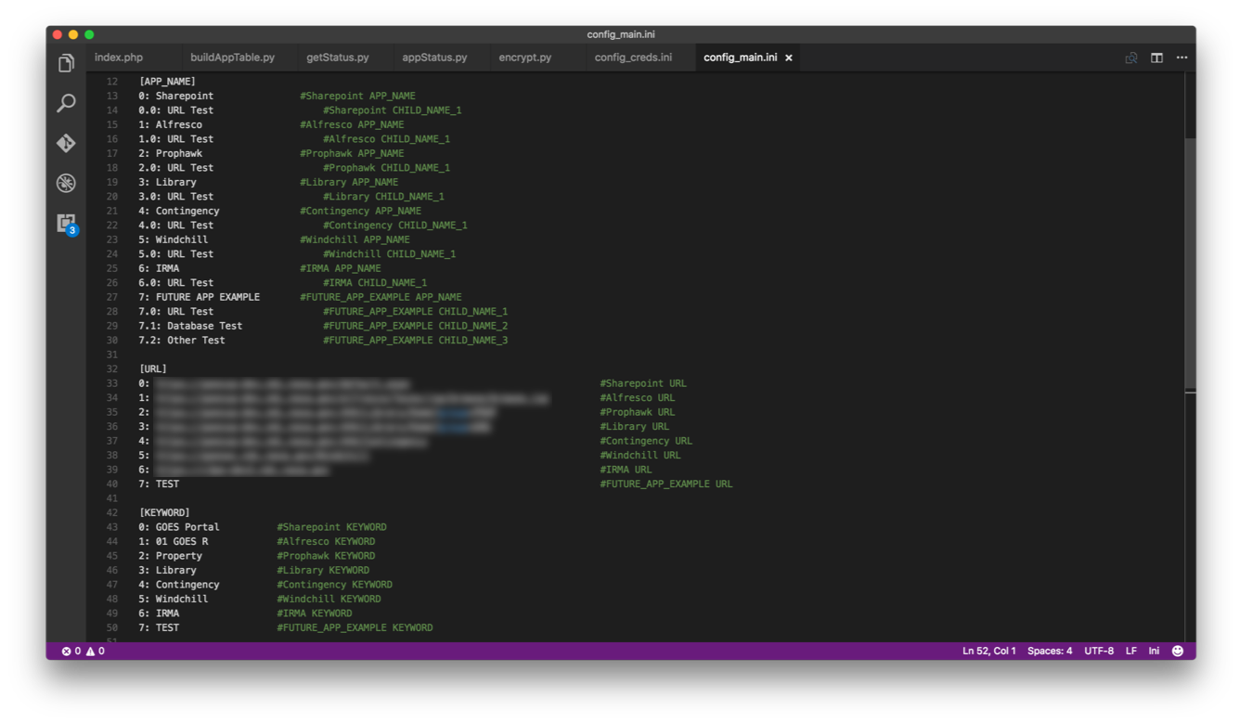
GOES App Status Portal
Read config_creds.ini file and encrypt username/password credentials
Read config_main.ini file to get application Name, URL and Keyword
Send a HTTP request to the application’s URL
Pass credentials as parameters to authenticate through NTLM (NT LAN Manager) and access the page
After web server returns a response, read the HTML contents
Search through HTML contents and find application’s Keyword
Notes:
As the user is on the page, there is a python program that is being executed in the background
Here is a demonstration of how it works to determine whether an application is online or offline.
To protect sensitive information that’s on the server

Slide 7

Weather Station Website (COWS Project)
Raspberry Pi (Apache/2.4.10 Server):
http://10.1.120.56/
Internal
Dennis Chesters’s GOES Project Science Webpage
http://goes.gsfc.nasa.gov/test/weatherstation.html
Public
Notes:
The Weather Station Website is hosted on two different web servers:
The first is hosted locally on the raspberry pi using an Apache server.
This server can be viewed only to users on the NASA network.
The second server is hosted globally on the internet on Dennis Chester’s GOES Project Science Webpage.
Dennis basically pulls the data from the Raspberry Pi’s URL and saves it to his server so it can be viewed by the public.

Slide 8
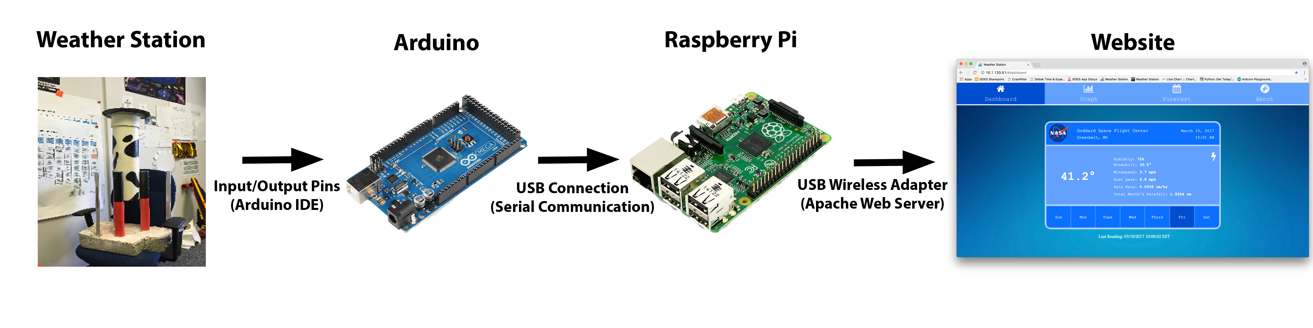
Arduino Software
Sensor data from the weather station is collected by an Arduino Mega 2560 microcontroller board
Developed a Java program using the Arduino IDE that collects sensor data: DHT22, Anemometer, Rain Gauge/Ultrasonic
The code is then uploaded to Arduino board and output is displayed through it’s built-in Serial Monitor
Notes:
All the sensors in the weather station are wired to the Arduino board

Slide 9
Raspberry Pi Software
The Raspberry Pi hosting the Weather Station website
Interfacing Arduino with Raspberry Pi by Serial Communication
Created a Python program that reads the Arduino output from the Serial Monitor and then saves the data into a text file
Notes:
The Raspberry Pi is going to serve as a mini, open-source Linux computer hosting the weather station website on NASA’s guest network
The next step would be to hook up the Arduino with the Raspberry pi by USB Connection and then interface the two by Serial Communication.
Serial communication port

Slide 10
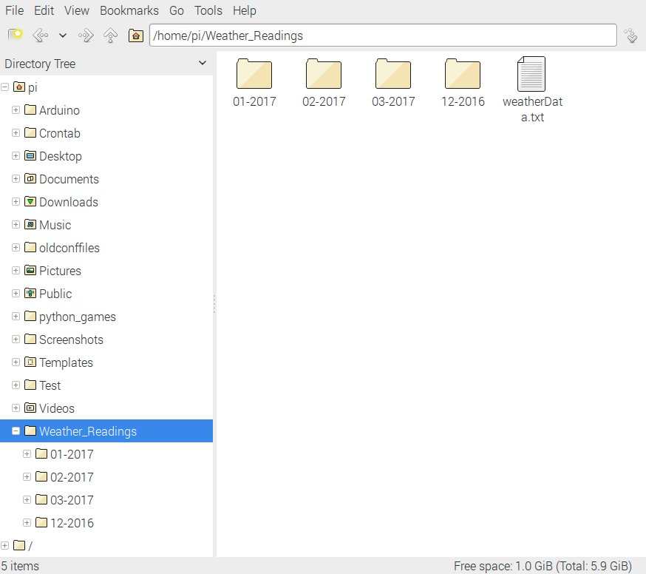
Archiving Weather Data
Notes:
As the program is reading and collecting data, it is being stored in the Weather Readings folder based on date.

Slide 11
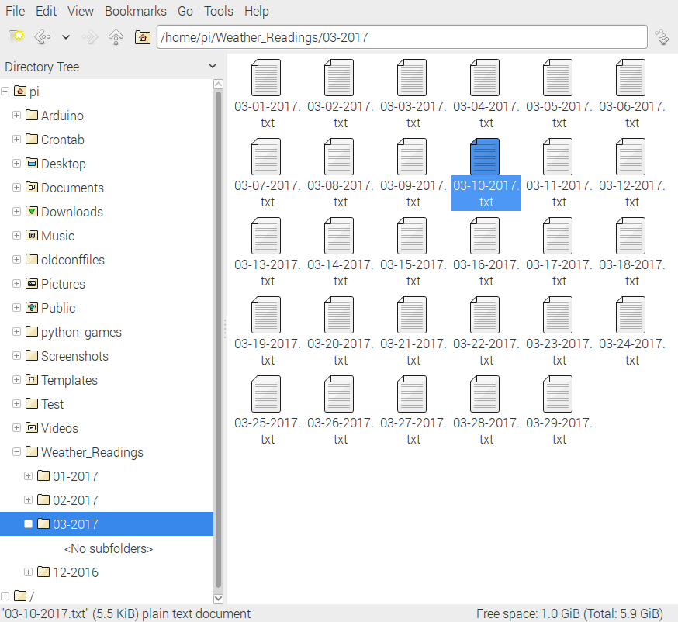
Archiving Weather Data
Notes:
Each month folder is divided into each day.

Slide 12
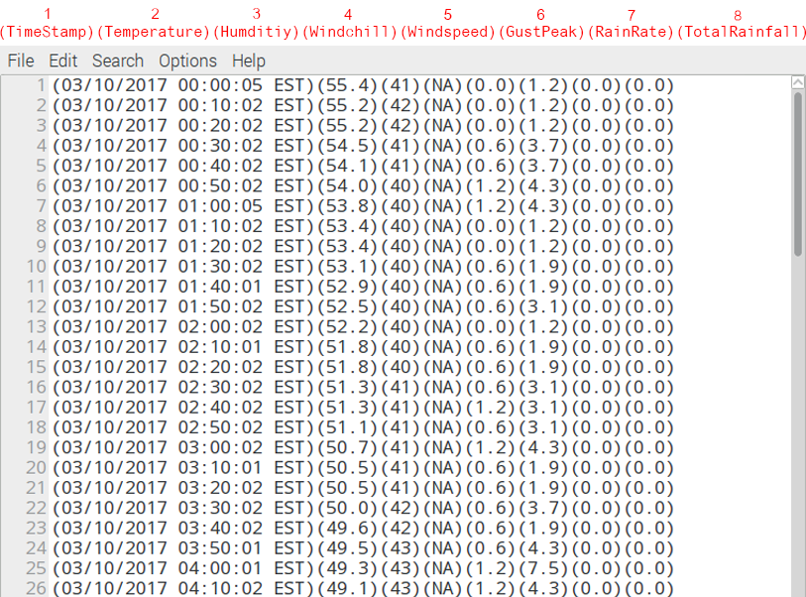
Archiving Weather Data
Notes:
And inside the day text file holds the weather data.
As you can see, weather data is collected every 10 minutes and appended into the text file.
The first line for example was March 10th, 2017 12:00am EST. with temperature of…

Slide 13
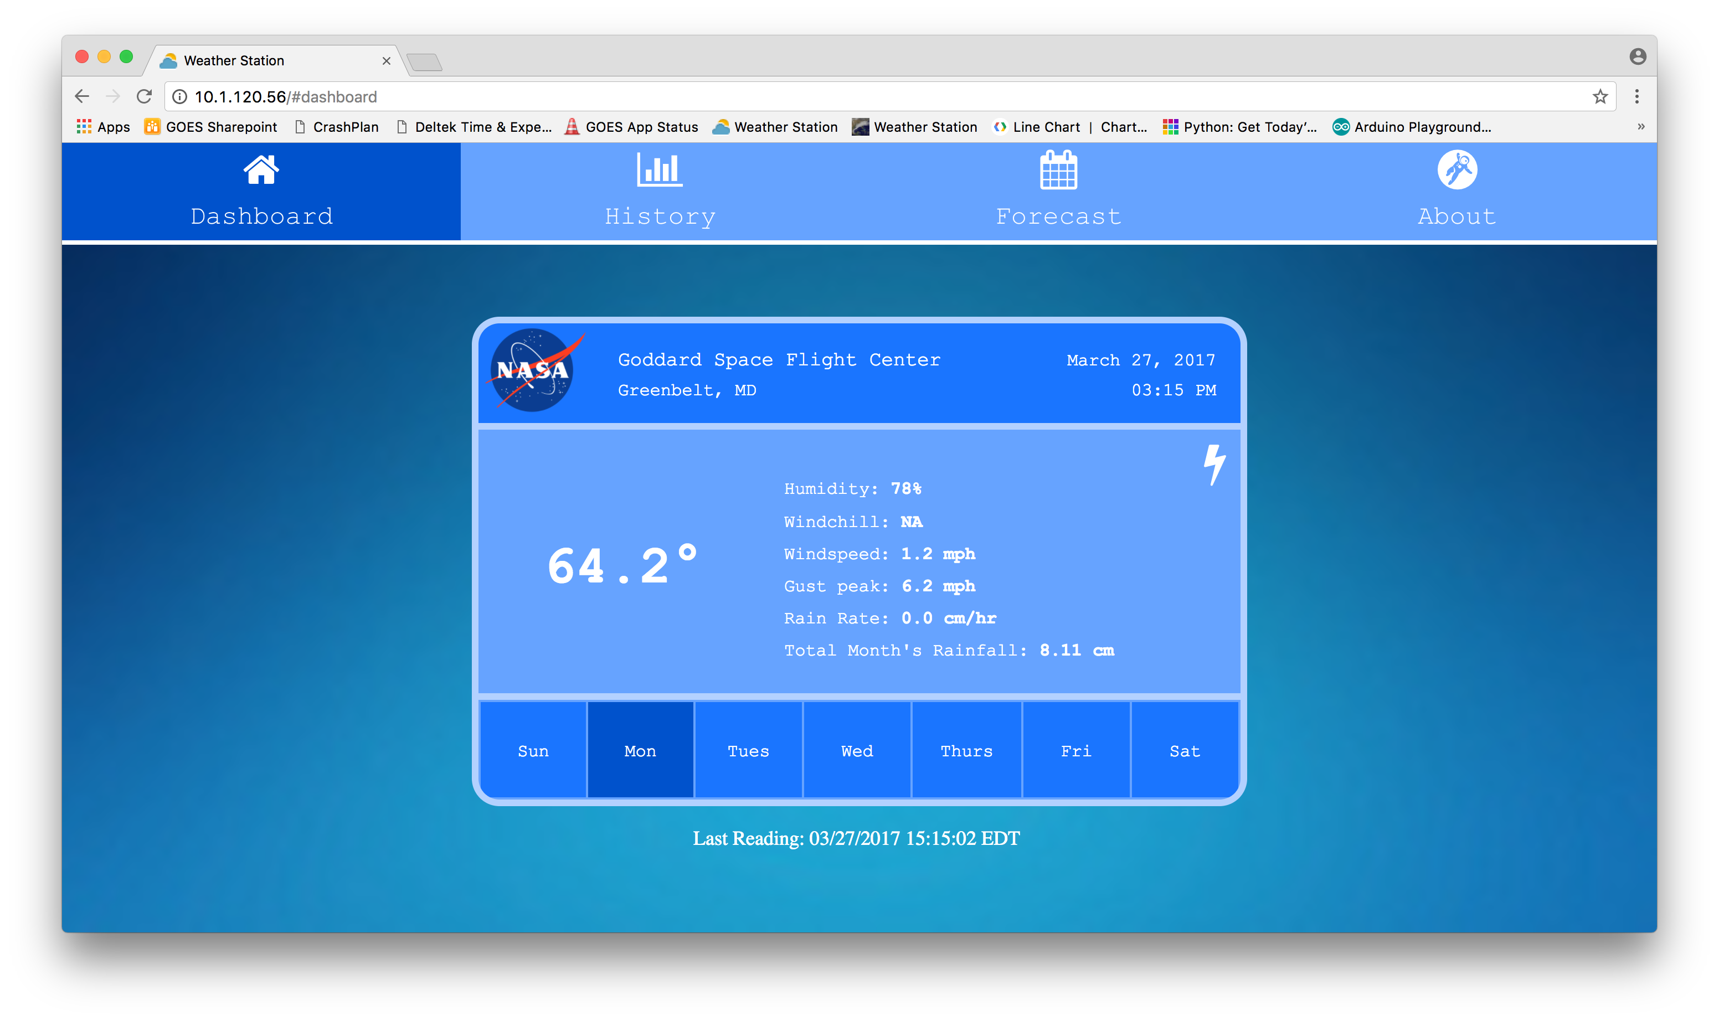
Current Weather Conditions
Notes:
This test file data is then projected on the weather station webpage
When the user clicks the lightning icon, it directs the user to a statistical page of the lightning detector that is located upsides.
On this page has information regarding lightning stroke count, signal count, etc.

Slide 14
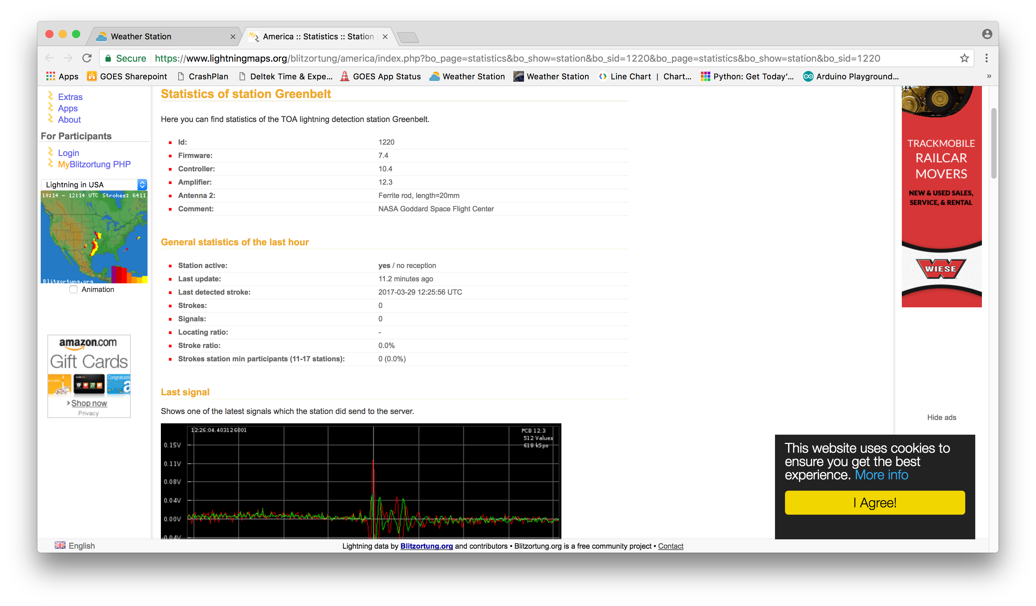
Lightning Detector Data
Notes:
This test file data is then projected on the weather station webpage
When the user clicks the lightning icon, it directs the user to a statistical page of the lightning detector that is located upsides.
On this page has information regarding lightning stroke count, signal count, etc.

Slide 15
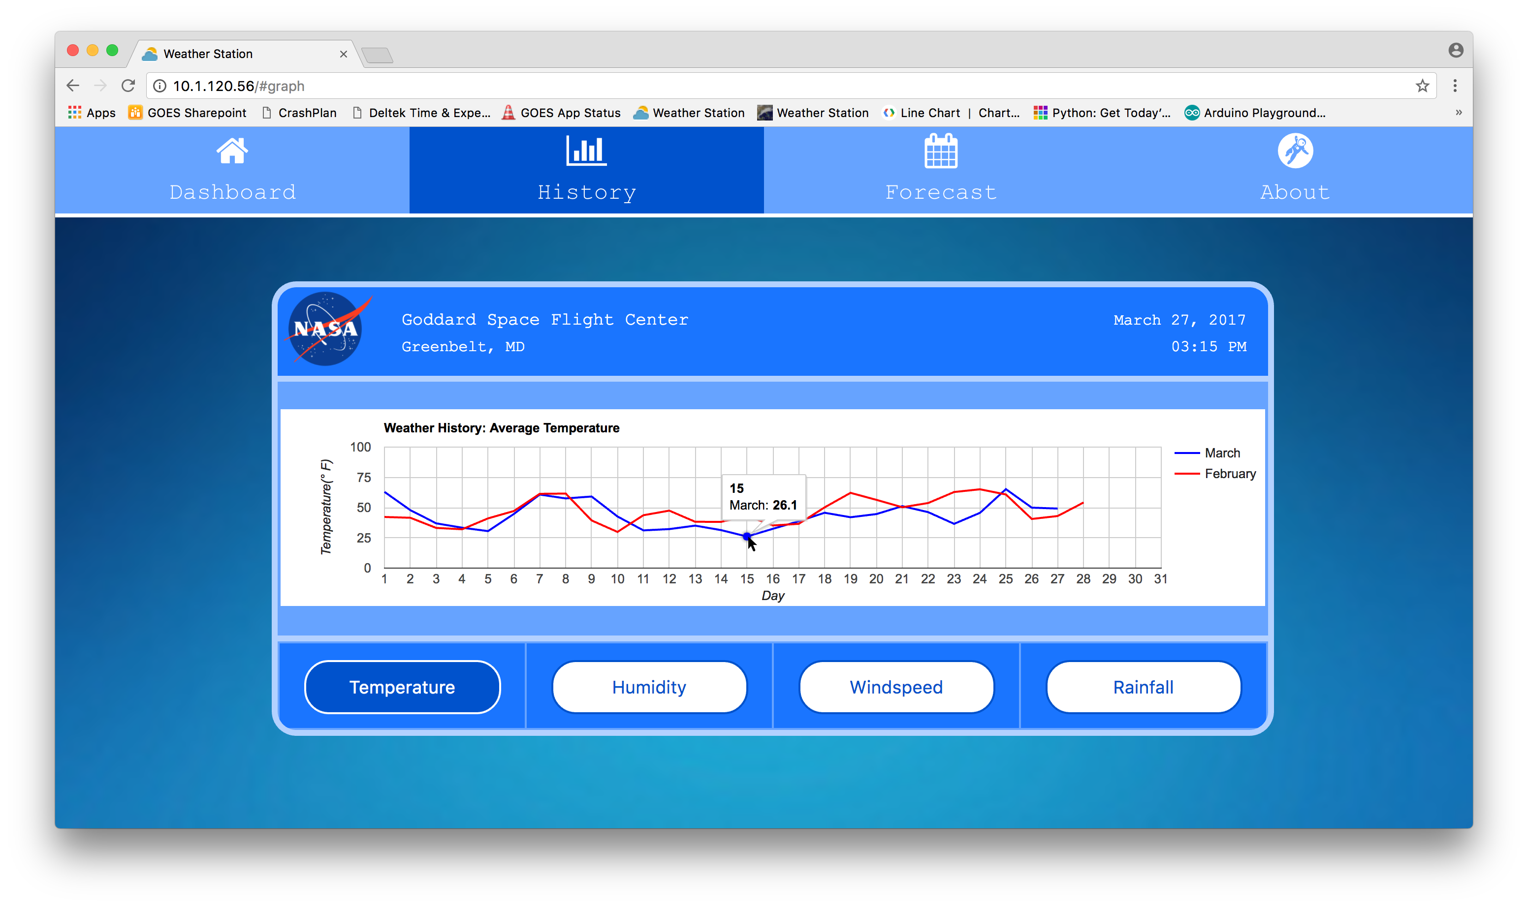
Weather History Graph

Slide 16
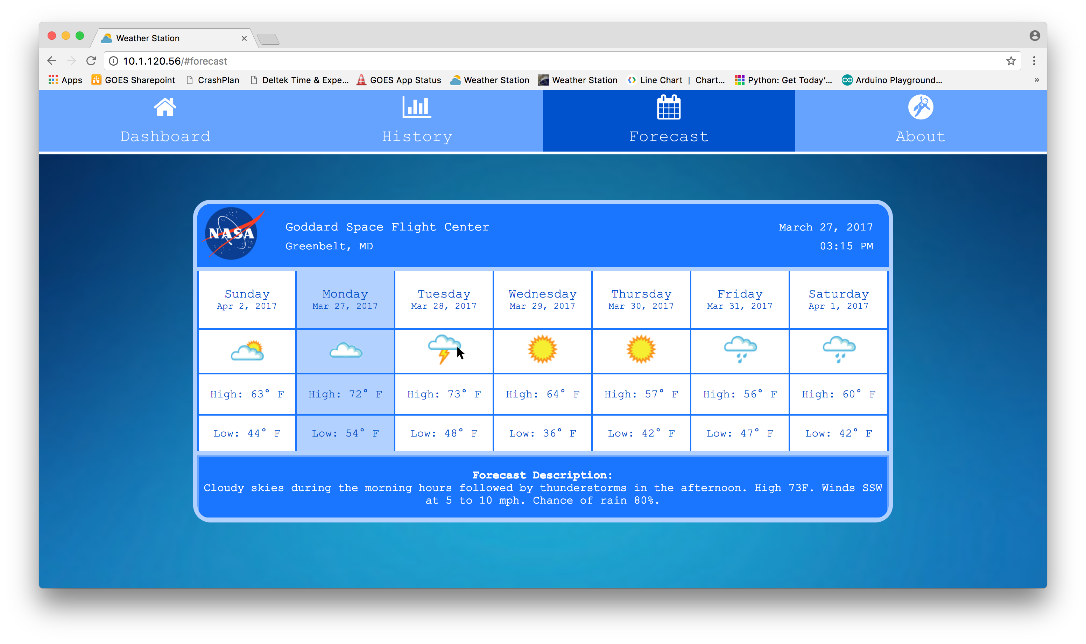
Wunderground API Forecast
Notes:
When the user clicks the Forecast button, it sends an API request to Wunderground and returns JSON data.
I extract out the weather icon, temp high, temp low, and forecast description.

Slide 17
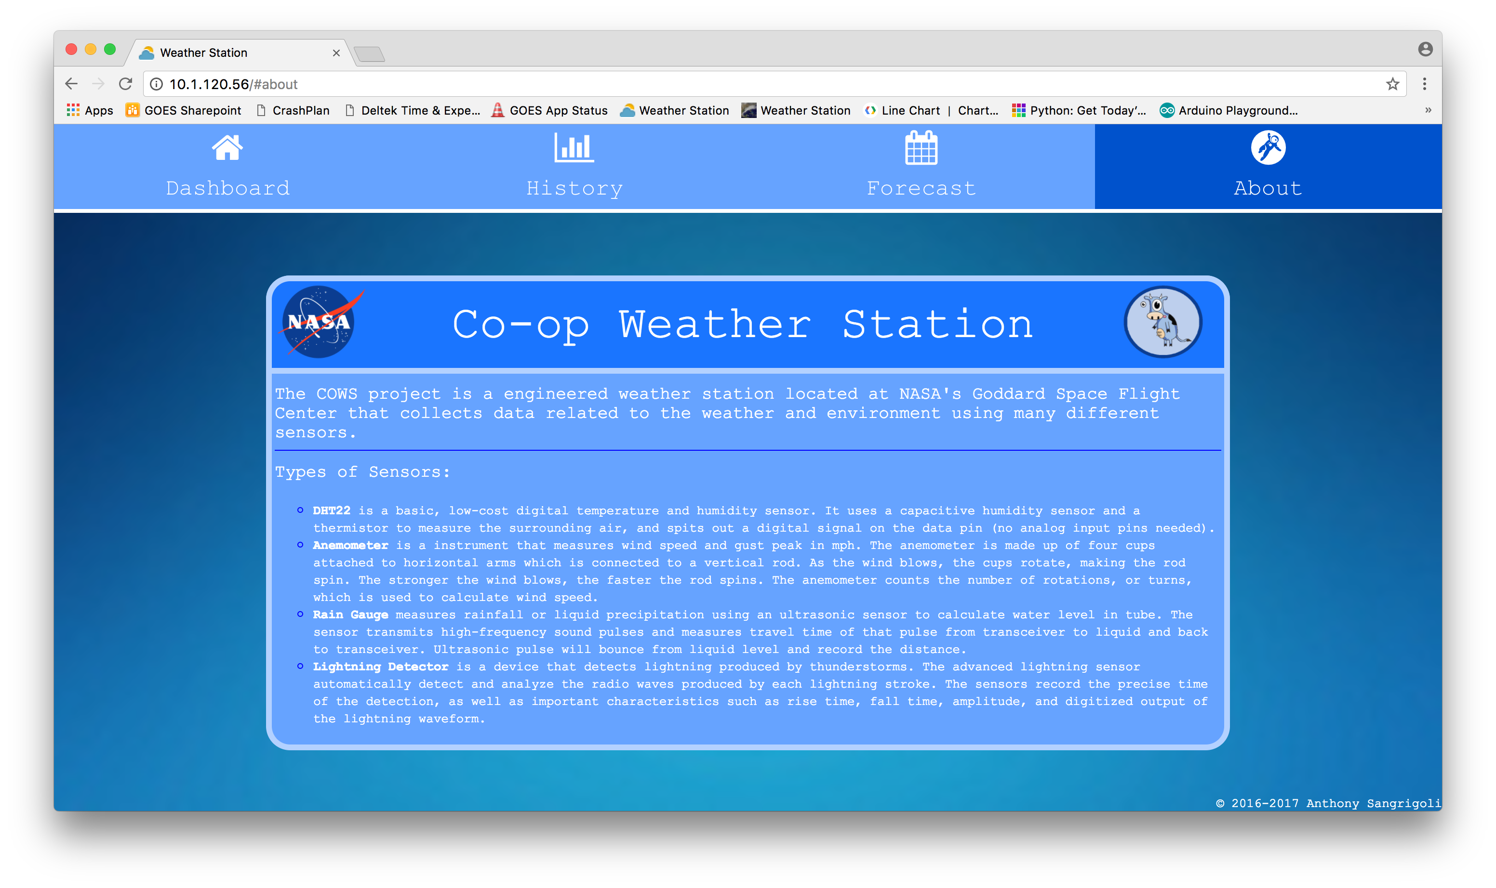
About COWS Project

Slide 18
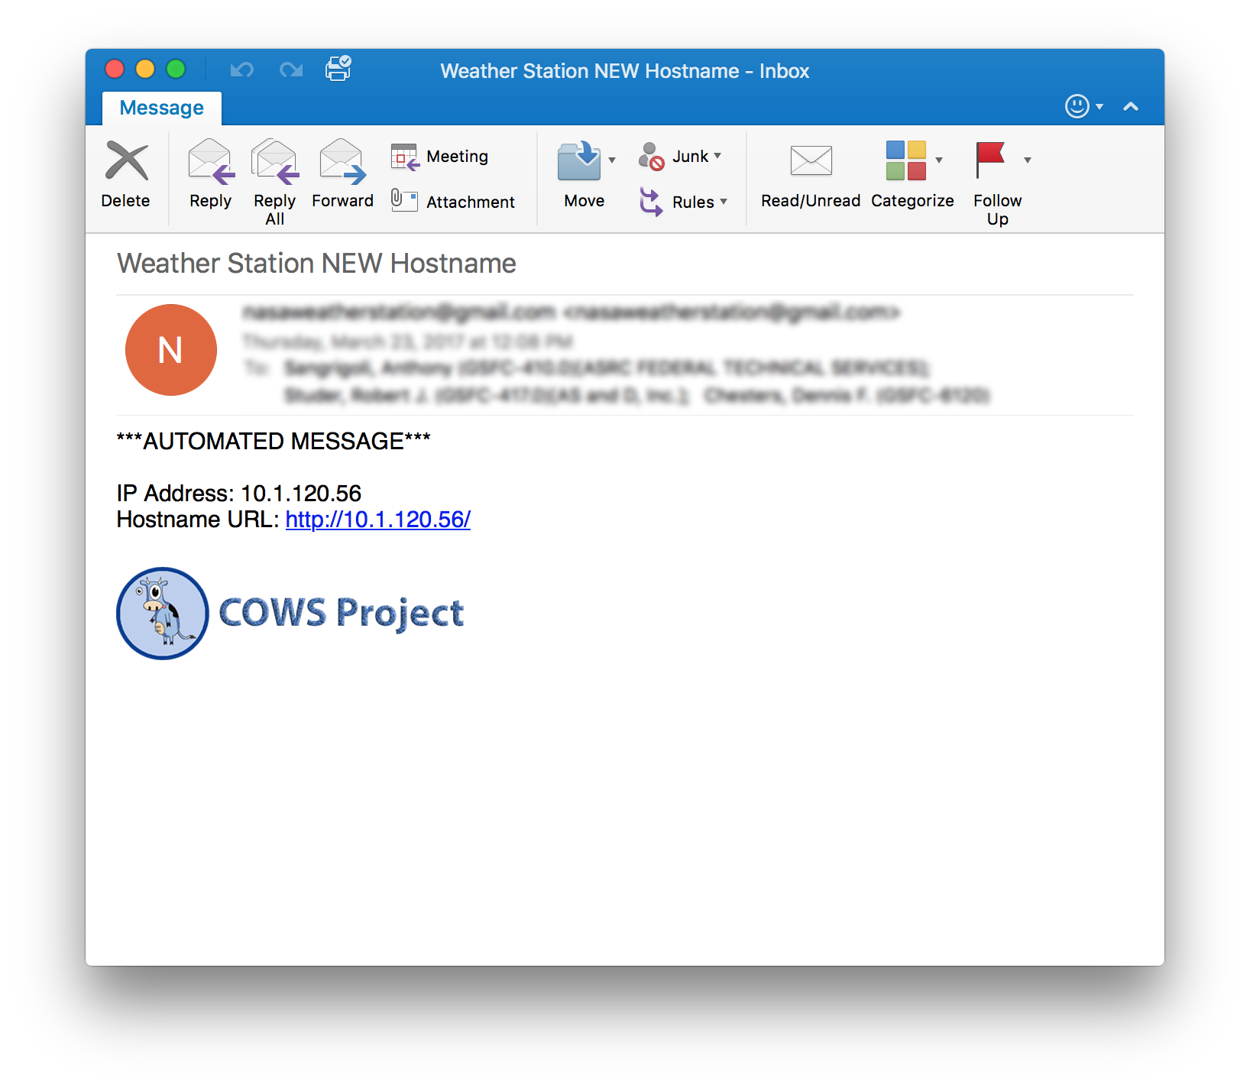
Challenges
Valid and Reliable Weather Station Data
Manual testing of each independent sensor
Comparing observed readings with actual readings
NASA’s Guest Network
Raspberry Pi gets booted off network
Raspberry Pi’s Dynamic IP Address
Notes:
I’ve spent a great amount of time testing each independent sensor trying to get consistent data.
Monitor and compare my readings with other stations near by
Not approved device on NASA network
If you ever connected to the guest network, you would know that your device would get kicked offline after 7 days or so and makes you re-submit a form to gain access again.
This is a huge problem because someone would have to go upstairs every week and submit the form just to make it operational.
So, I developed a python program in which every time the Pi gets kicked offline it automatically fills out the guest network form and submits it to re-connect.
The Pi cannot have a static IP which means it changes over time. Created a python program that sends an automated message to recipients of the new ip address

Slide 19
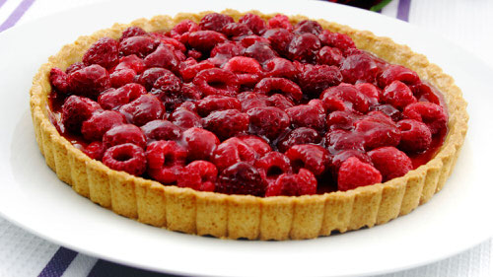
What I Learned
Raspberry Pi was not in fact a Raspberry Pie
How to extract information from websites by the process of data scraping
Better programming practices to make code more modular and easier to debug
How to program an Arduino to collect and convert sensor data into weather data
Automating web browser actions
Notes:
cron is a time-based job scheduler in Unix-like computer operating systems.

